Slide 1
Azure Data Factory Hybrid data integration, at global scale
Speaker Name
Title

Slide 2

The world is changing
Notes:
Let’s start by talking about how the world is changing
We all aspire to create disruption that
constructs new realities for customers and
builds a distinct advantage for our organizations.
In order to make that leap, we have to look across trends and decide:
which variables and trends we need to care about
which ones will prevail
which ones we invest in

Slide 3
Data will grow to 44 ZB in 2020
Today, 80% of organizations adopt cloud-first strategies
AI investment increased by
300% in 2017
Notes:
We’ve identified 3 major trends we believe will heavily shape and shoulder disruption in the future
The 1st is the astronomical explosion of data
By 2020, data will reach 44ZB, quadruple what it is today
The 2nd trend is cloud adoption
4 out of every 5 companies invest in public cloud technologies
The 3rd major trend is artificial intelligence
AI gives life to all that data we’re creating
This year alone, investment in AI has increased 300%

Slide 4
Organizations that harness data, cloud, and AI outperform
Notes:
Organizations that harness data, cloud, and AI OUT PERFORM
<click>

Slide 5
There are barriers to getting value from data
Data silos
Incongruent data types
Complexity of solutions
Multi cloud environment
Rising costs
Data integration
Support for diverse data models
Unlimited
scale
Fully-managed infrastructure
Lower TCO
On-premises, in the cloud or hybrid
Notes:
Through a Keystone research study we learned companies in the top quartile for “investing in their data platform” vastly outperformed companies in the bottom quartile
With double the operating margin, they are crushing the competition
Investments ALONE don’t make you money and they don’t give you a competitive edge.
Investments enable innovation. This leads us to our second point that….

Slide 6
Derive real value from your data
Data silos
Incongruent data types
Performance constraints
Complexity of solutions
Rising costs
One hub for
all data
Support for diverse types of data
Unlimited
data scale
Familiar tools and ecosystem
Lower TCO
On-premises, hybrid, Azure
Notes:
Through a Keystone research study we learned companies in the top quartile for “investing in their data platform” vastly outperformed companies in the bottom quartile
With double the operating margin, they are crushing the competition
Investments ALONE don’t make you money and they don’t give you a competitive edge.
Investments enable innovation. This leads us to our second point that….

Slide 7
Organizations that harness data, cloud, and AI outperform
Nearly double
operating margin
$100M in additional
operating income
Notes:
Through a Keystone research study we learned companies in the top quartile for “investing in their data platform” vastly outperformed companies in the bottom quartile
With double the operating margin, they are crushing the competition
Investments ALONE don’t make you money and they don’t give you a competitive edge.
Investments enable innovation. This leads us to our second point that….

Slide 8
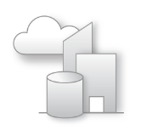



Azure data factory
A fully-managed data integration service in the cloud
PRODUCTIVE
HYBRID
SCALABLE
TRUSTED
Drag & Drop UI
Codeless Data Movement
Orchestrate where your data lives
Lift SSIS packages to Azure
Serverless scalability with no infrastructure to manage
Certified compliant Data Movement

Slide 9



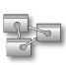
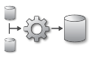
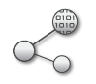
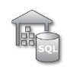


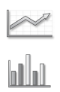

Azure data factory
Modernize your enterprise data warehouse at scale
Integrate via Azure Data Factory
LOB
INGEST
STORE
PREP & TRANSFORM
MODEL & SERVE
Cloud
CRM
Graph
Azure Analysis Services
Image
VNet
Social
Data orchestration, scheduling and monitoring
Azure Data Lake Azure Storage
Data Transformations
Machine Learning
Azure SQL DW,
HDInsight, Data Lakes
Apps and Insights
IoT
On-premise

Slide 10







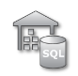
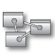


Azure data factory
Modernize your enterprise data warehouse at scale
Orchestrate with Azure Data Factory
INGEST
STORE
PREP & TRAIN
MODEL & SERVE
On-premises data
Oracle, SQL, Teradata, fileshares, SAP
Azure Databricks
Cloud data
Azure, AWS, GCP
Azure Data Factory
Azure Blob Storage
Polybase
Azure SQL Data Warehouse
Azure Analysis Services
Power BI
SaaS data
Salesforce, Workday, Dynamics
Microsoft Azure also supports other Big Data services like Azure HDInsight, Azure SQL Database and Azure Data Lake to allow customers to tailor the above architecture to meet their unique needs.

Slide 11
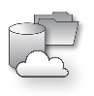

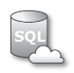




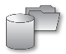
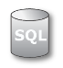
Lift your SQL Server Integration Services (SSIS) packages to Azure
Azure Data Factory
SSIS Integration Runtime
Cloud data sources
SSIS Cloud ETL
SQL DB Managed Instance
Cloud
On-premises
VNET
Microsoft
SQL Server
Integration Services
On-Premise data sources
SQL Server

Slide 12


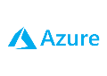


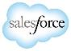
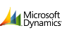
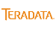



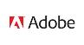
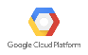
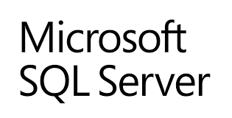
Hybrid and Multi-Cloud Data Integration
Azure Data Factory
PaaS Data Integration
DATA DRIVEN APPLICATIONS
Author, orchestrate and monitor with Azure Data Factory
On-Prem
SaaS Apps
Public Cloud
DATA SCIENCE AND MACHINE LEARNING MODELS
ANALYTICAL DASHBOARDS USING POWER BI

Slide 13
Access all your data
65+ connectors & growing
Azure IR available in 20 regions
Hybrid connectivity using self-hosted IR: on-prem & VNet
Azure | Database |  | File Storage | NoSQL | Services and Apps |  | Generic
Azure Blob Storage | Amazon Redshift | SQL Server | Amazon S3 | Couchbase | Dynamics 365 | Salesforce | HTTP
Azure Data Lake Store | Oracle | MySQL | File System | Cassandra | Dynamics CRM | Salesforce Service Cloud | OData
Azure SQL DB | Netezza | PostgreSQL | FTP | MongoDB | SAP C4C | ServiceNow | ODBC
Azure SQL DW | SAP BW | SAP HANA | SFTP |  | Oracle CRM | Hubspot
Azure Cosmos DB | Google BigQuery | Informix | HDFS |  | Oracle Service Cloud | Marketo
Azure DB for MySQL | Sybase | DB2 |  |  | SAP ECC | Oracle Responsys
Azure DB for PostgreSQL | Greenplum | MariaDB |  |  | Zendesk | Oracle Eloqua
Azure Search | Microsoft Access | Drill |  |  | Zoho CRM | Salesforce ExactTarget
Azure Table Storage | Hive | Phoenix |  |  | Amazon Marketplace | Atlassian Jira
Azure File Storage | Hbase | Presto |  |  | Megento | Concur
 | Impala | Spark |  |  | PayPal | QuickBooks Online
 | Vertica |  |  |  | Shopify | Xero
 |  |  |  |  | GE Historian | Square
 |  |  |  |  | Web table
* Supported file formats: CSV, AVRO, ORC, Parquet, JSON

Slide 14
Control Flow Introduced in Azure Data Factory
Coordinate pipeline activities into finite execution steps to enable looping, conditionals and chaining while separating data transformations into individual data flows
My Pipeline 1
For Each…
My Pipeline 2
Trigger
Event
Wall Clock
On Demand
Success, params
Activity 1
Success, params
Activity 2
Activity 3
Activity 1
Activity 4
Activity 2
Error, params
“On Error” Activity 1
…
…

Slide 15

Azure Data Factory Updated Flexible Application Model
Triggers
Trigger Runs
Pipeline
Pipeline Runs
Linked Service
Data Movement
Activity
Integration Runtime
Activity
Data Transformation
Dispatch
Dataset
Activity
Activity Runs
Notes:
A data factory can have one or more pipelines. A pipeline is a logical grouping of activities that together perform a task. The activities in a pipeline define actions to perform on your data. For example, you might use a copy activity to copy data from an on-premises SQL Server to Azure Blob storage. Then, you might use a Hive activity that runs a Hive script on an Azure HDInsight cluster to process data from Blob storage to produce output data. Finally, you might use a second copy activity to copy the output data to Azure SQL Data Warehouse, on top of which business intelligence (BI) reporting solutions are built.
A dataset is a named view of data that references the data and the structure of the data you want to use in your activities as inputs and outputs. Datasets identify data within different data stores, such as tables, files, folders, and documents. For example, an Azure Blob dataset specifies the blob container and folder in Blob storage from which the activity should read the data.
Before you create a dataset, you must create a linked service to link your data store to the data factory. Linked services are much like connection strings, which define the connection information needed for Data Factory to connect to external resources. Think of it this way; the dataset represents the structure of the data within the linked data stores, and the linked service defines the connection to the data source. For example, an Azure Storage linked service links a storage account to the data factory. An Azure Blob dataset represents the blob container and the folder within that Azure storage account that contains the input blobs to be processed.

Slide 16
ADF: Cloud-First Data Integration Objectives
Consume hybrid disparate data
On-prem + Cloud
Grow ADF ecosystem of structured, un-structured, semi-structured data connectors
Calculate and format data for analytics
Transform, aggregate, join, normalize
Separate data flow (transformation) from control flow (orchestration)
Address large-scale Big Data requirements
Scale-up or Scale-out data movement and transformation
Support multiple processing engines
Operationalize
Support flexible scheduling and triggering mechanism for broad range of use cases
Manage & monitor multiple pipelines (via Azure Monitor & OMS)
Support secure VNET environments
Lift and Shift SSIS to the Cloud
Execute SSIS packages in ADF Integration Runtime

Slide 17
ADF: Cloud-First Data Integration Scenarios
Lift and Shift to the Cloud
Migrate on-prem DW to Azure
Lift and shift existing on-prem SSIS packages to cloud
No changes needed to migrate SSIS packages to Cloud service
DW Modernization
Modernizing DW arch to reduce cost & scale to needs of big data (volume, variety, etc)
Flexible wall-clock and triggered event scheduling
Incremental Data Load
Build Data-Driven, Intelligent SaaS Application
C#, Python, PowerShell, ARM support
Big Data Analytics
Customer profiling, Product recommendations, Sentiment Analysis, Churn Analysis, Customized offers, customer usage tracking, customized marketing
On-demand Spark cluster support
Load your Data Lake
Separate control-flow to orchestrate complex patterns with branching, looping, conditional processing

Slide 18
ADF V2 Improvements
Integration Runtimes (IR) replace DMG, provide data movement and activity dispatch on-prem or in the cloud
Supports resources within virtual networks
Integration Runtime includes SSIS option to lift & shift SSIS packages to the Cloud
Separation of “control flow” & “data flow” capabilities for more flexible pipeline management
Looping, conditionals, dependencies, parameters
Python SDK
Built-in Source Control Support
On-Demand Spark support
Transform data in Azure Databricks
Flexible pipeline scheduling with wall-clock, tumbling windows and triggered executions
Expanded use cases: From primarily time window-oriented pipelines, to trigger-based on-demand for more flexible ETL and data integration orchestrations
Graphical UI pipeline builder for a code-free experience

Slide 19
New ADF V2 Concepts
Concept | Description | Sample
Control Flow | Orchestration of pipeline activities that includes chaining activities in a sequence, branching, conditional branching based on an expression, parameters that can be defined at the pipeline level and arguments passed while invoking the pipeline on demand or from a trigger. Also includes custom state passing and looping containers, I.e. For-each, Do-Until iterators. | { "name":"MyForEachActivityName", "type":"ForEach", "typeProperties":{ "isSequential":"true", "items":"@pipeline().parameters.mySinkDatasetFolderPathCollection", "activities":[ { "name":"MyCopyActivity", "type":"Copy", "typeProperties": …
Runs | A Run is an instance of the pipeline execution. Pipeline Runs are typically instantiated by passing the arguments to the parameters defined in the Pipelines. The arguments can be passed manually or properties created by the Triggers. | POST https://management.azure.com/subscriptions/<subId>/resourceGroups/<resourceGroupName>/providers/Microsoft.DataFactory/factories/<dataFactoryName>/pipelines/<pipelineName>/createRun?api-version=2017-03-01-preview
Activity Logs | Every activity execution in a pipeline generates activity start and activity end logs event
Integration Runtime | Replaces DMG as a way to move & process data in Azure PaaS Services, self-hosted or on prem or IaaS Works with VNETs Enables SSIS package execution | Set-AzureRmDataFactoryV2IntegrationRuntime -Name $integrationRuntimeName -Type SelfHosted
Scheduling | Flexible Scheduling Wall-clock scheduling Event-based triggers | "type": "ScheduleTrigger", "typeProperties": { "recurrence": { "frequency": <<Minute, Hour, Day, Week, Year>>, "interval": <<int>>, // optional, how often to fire (default to 1) "startTime": <<datetime>>, "endTime": <<datetime>>, "timeZone": <<default UTC>> "schedule": { // optional (advanced scheduling specifics) "hours": [<<0-24>>], "weekDays": ": [<<Monday-Sunday>>], "minutes": [<<0-60>>], "monthDays": [<<1-31>>], "monthlyOccurences": [ { "day": <<Monday-Sunday>>, "occurrence": <<1-5>>

Slide 20
New ADF V2 Concepts
Concept | Description | Sample
On-Demand Execution | Instantiate a pipeline by passing arguments as parameters defined in a pipeline and execute from script / REST / API. | Invoke-AzureRmDataFactoryV2PipelineRun -DataFactory $df -PipelineName "Adfv2QuickStartPipeline" -ParameterFile .\PipelineParameters.json
Parameters | Name-value pairs defined in the pipeline. Arguments for the defined parameters are passed during execution from the run context created by a Trigger or pipeline executed manually. Activities within the pipeline consume the parameter values. A Dataset is a strongly typed parameter and a reusable/referenceable entity. An activity can reference datasets and can consume the properties defined in the Dataset definition A Linked Service is also a strongly typed parameter containing the connection information to either a data store or a compute environment. It is also a reusable/referenceable entity. | Accessing parameters of other activities Using expressions @parameters(“{name of parameter}”) @activity(“{Name of Activity}”).output.RowsCopied
Incremental Data Loading | Leverage parameters and define your high-water mark for delta copy while moving dimension or reference tables from a relational store either on premises or in the cloud to load the data into the lake | name": "LookupWaterMarkActivity", "type": "Lookup", "typeProperties": { "source": { "type": "SqlSource", "sqlReaderQuery": "select * from watermarktable" }
On-Demand Spark | Support for on-demand HDI Spark clusters, similar to on-demand Hadoop activities in V1 | "type": "HDInsightOnDemand", "typeProperties": { "clusterSize": 2, "clusterType": "spark", "timeToLive": "00:15:00",
SSIS Runtime | Lift & shift, deploy, manage, monitor SSIS packages in the cloud with SSIS Azure IR Service in Azure Data Factory | Start-AzureRmDataFactoryV2IntegrationRuntime -DataFactoryName $DataFactoryName -Name
Code-free UI | Build end-to-end data pipeline solutions for ADF without writing code or JSON

Slide 21
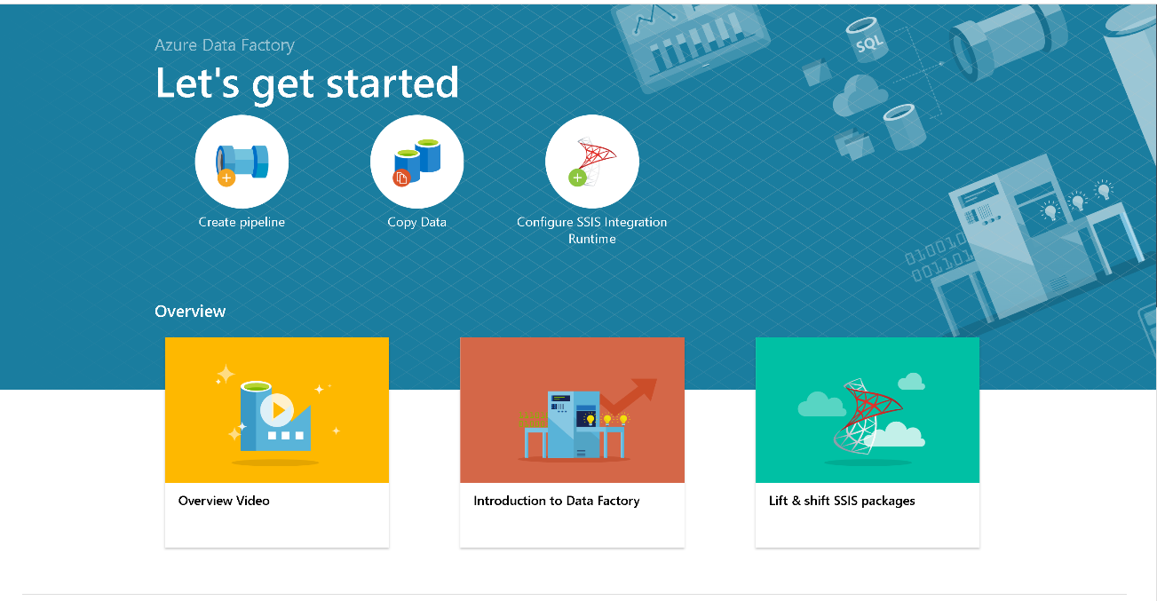

Slide 22
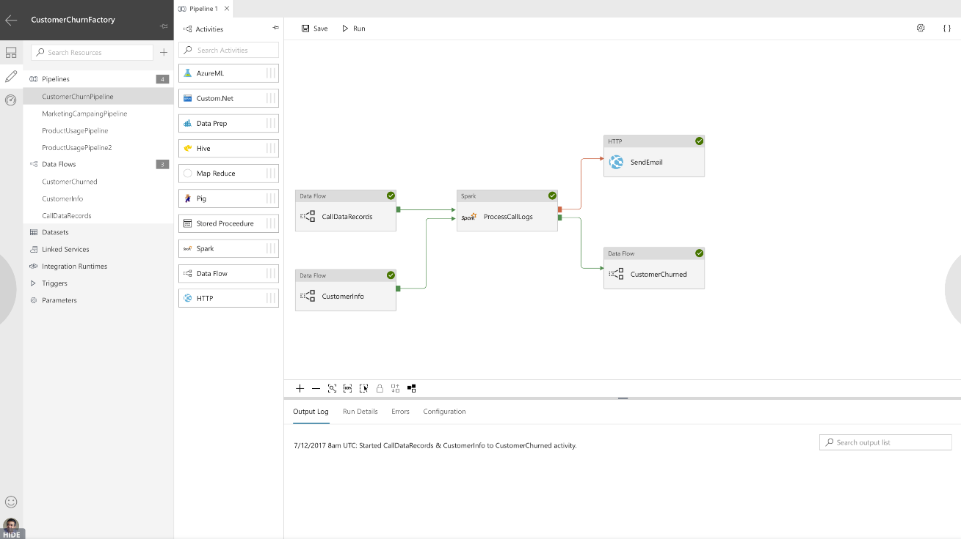
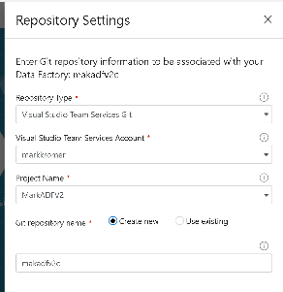
Built-in source control support

Slide 23
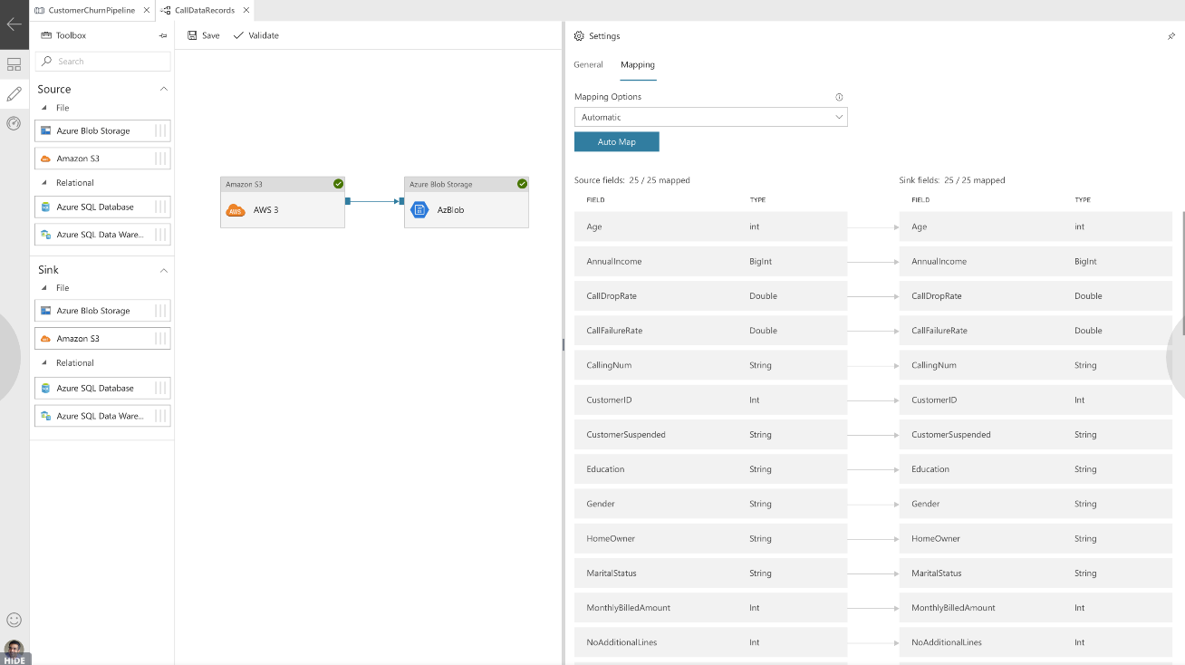

Slide 24
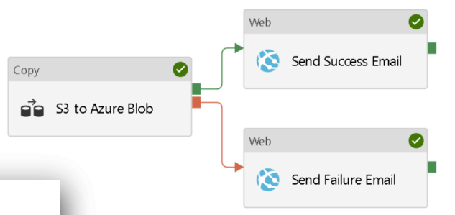
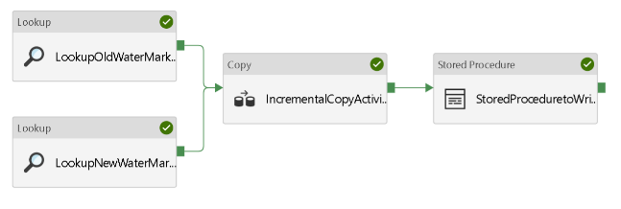
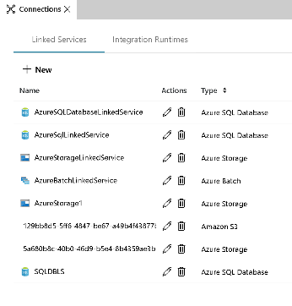
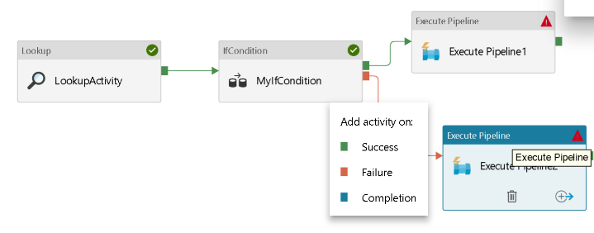
Incremental Delta Data Copy
Conditional execution
If-Then, Lookup, Execute Pipeline
Connection Managers

Slide 25
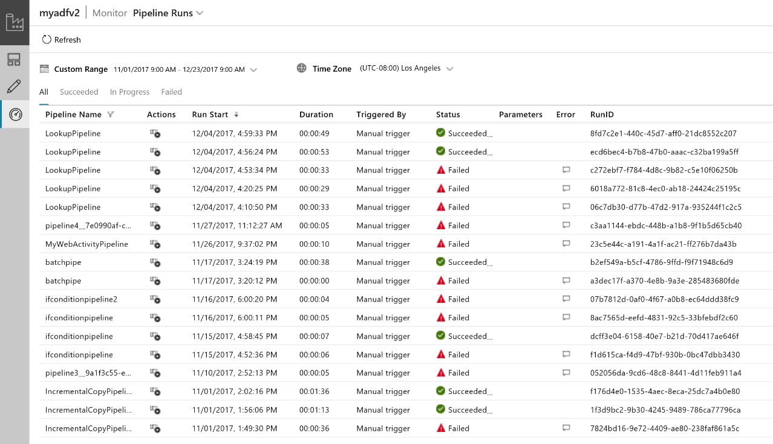
Operationalize – Monitor your data pipelines

Slide 26
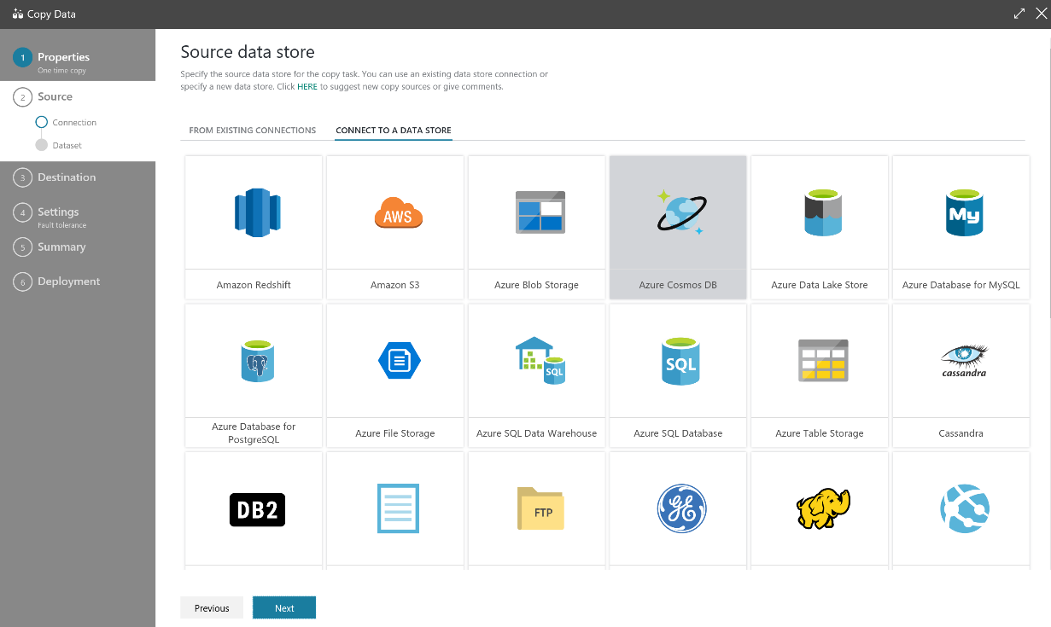
Easy-to-use Wizard for Copying Data at Scale

Slide 27
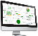

ADF Integration Runtime (IR)
ADF compute environment with multiple capabilities:
Activity dispatch & monitoring
Data movement
SSIS package execution
To integrate data flow and control flow across the enterprises’ hybrid cloud, customer can instantiate multiple IR instances for different network environments:
On premises (similar to DMG in ADF V1)
In public cloud
Inside VNet
Bring a consistent provision and monitoring experience across the network environments
Portal Application & SDK
Azure Data Factory Service
Self-Hosted IR
Azure IR
Data Movement & Activity Dispatch on-prem, Cloud, VNET
Data Movement & Activity Dispatch In Azure Public Network, SSIS
VNET coming soon

Slide 28
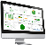


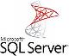
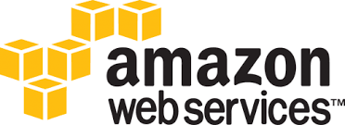
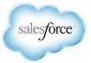

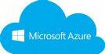


Command & Control
Data Flow
UX & SDK
Authoring | Monitoring/Mgmt
Azure Data Factory Service
Scheduling | Orchestration | Monitoring
On Premises Apps & Data
Cloud Apps, Svcs & Data

Slide 29
Command & Control
Data Flow
UX & SDK
Authoring | Monitoring/Mgmt
Azure Cloud
Azure Data Factory Service
Scheduling | Orchestration | Monitoring
PaaS Cloud Host
Integration Runtime
On Premises Apps & Data
Cloud Apps, Svcs & Data

Slide 30

Command & Control
Data Flow
UX & SDK
Authoring | Monitoring/Mgmt
Azure Cloud
Azure Data Factory Service
Scheduling | Orchestration | Monitoring
PaaS Cloud Host
Integration Runtime
Installable Agent
Integration Runtime
On Premises Apps & Data
Cloud Apps, Svcs & Data

Slide 31
Command & Control
Data Flow
UX & SDK
Authoring | Monitoring/Mgmt
Azure Cloud
Azure Data Factory Service
Scheduling | Orchestration | Monitoring
PaaS Cloud Host
Integration Runtime
Integration Runtime
- Activity Dispatch/Monitor (spark, copy, ml, etc)
- Data Movement
- SSIS Package Execution
Installable Agent
Integration Runtime
On Premises Apps & Data
Cloud Apps, Svcs & Data

Slide 32
Azure Data Factory “Integration Runtime” deployed on premises for transformation and then moved to cloud
Customer 1
Customer 1 firewall border
“IR”
ADF Foo On-prem

Slide 33
Azure Data Factory “Integration Runtime” deployed inside VNet
Customer 2
Customer 2 firewall border
Customer 2 vnet
“IR”
ADF Foo in vnet

Slide 34
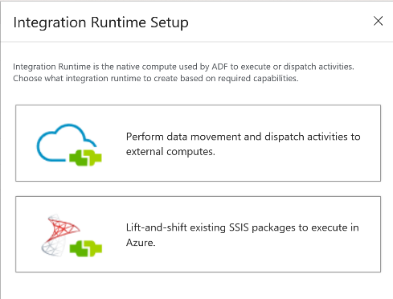
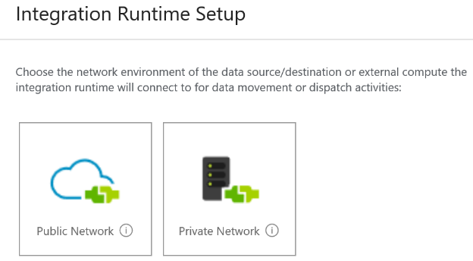
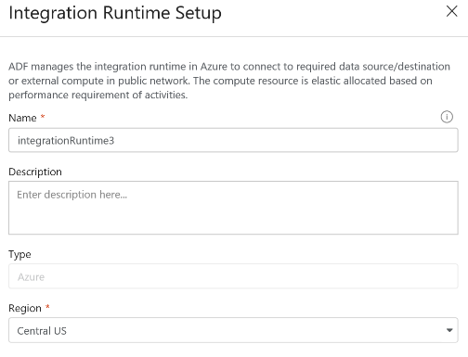

Slide 35
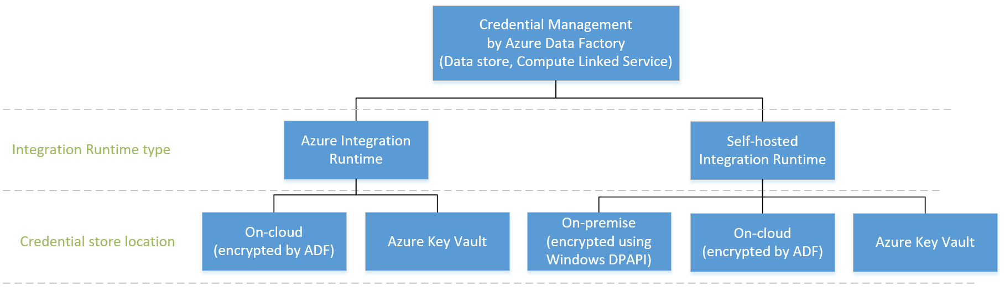
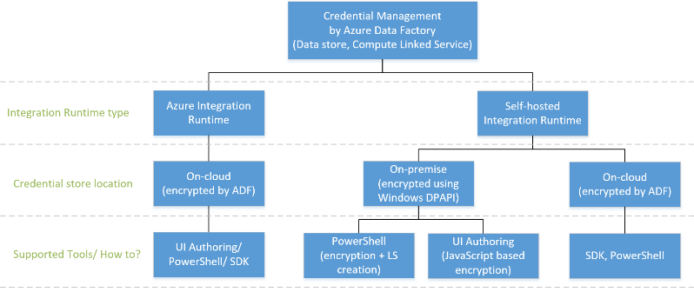
Credential Management (Linked service)
Notes:
Add akv, combine powershell+ui authoring

Slide 36
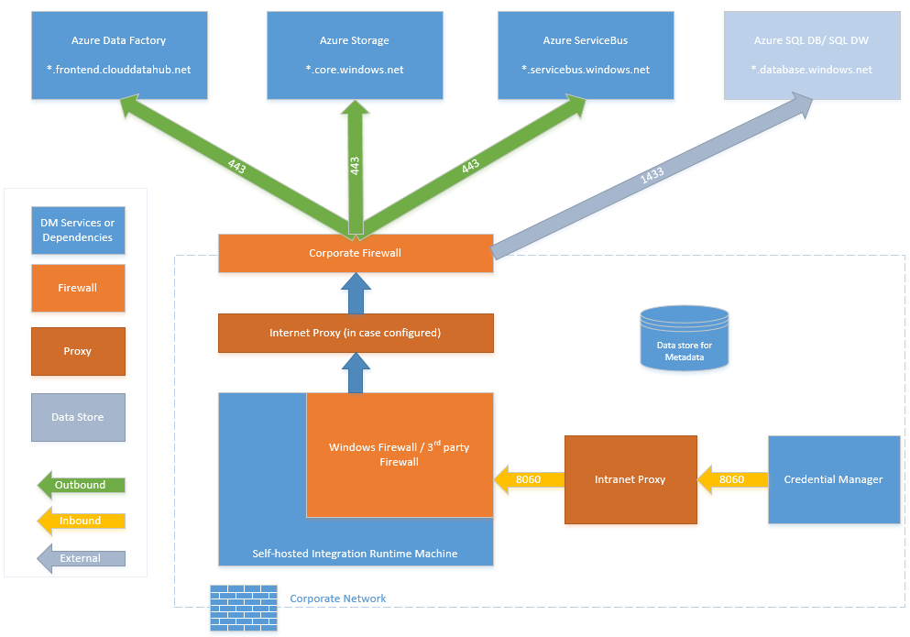
Self-hosted IR – Firewall Requirements

Slide 37
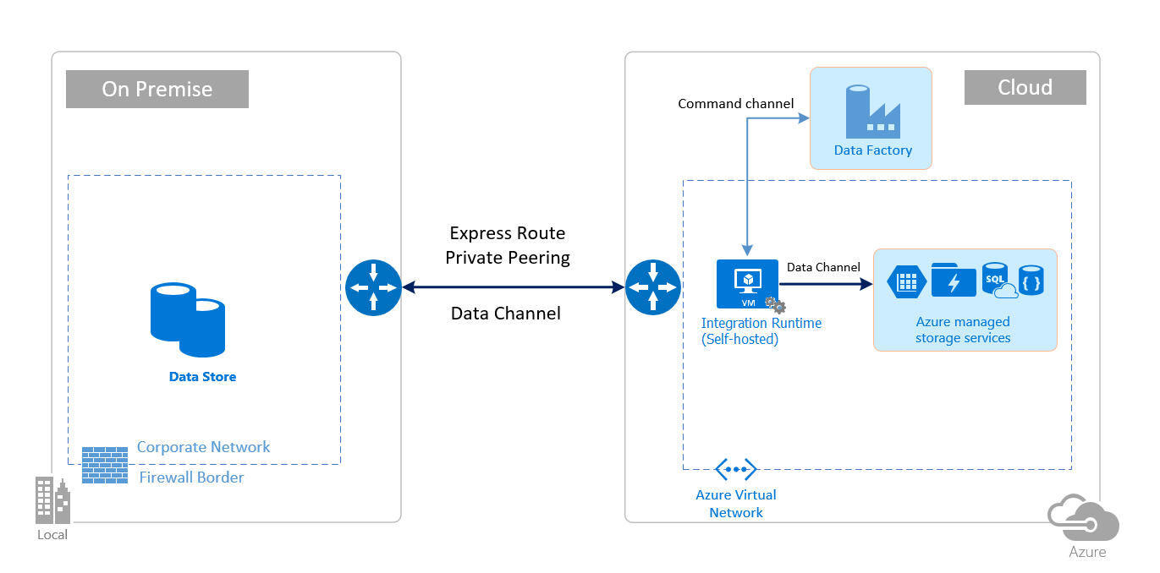
Network Topology (with ExpressRoute)

Slide 38
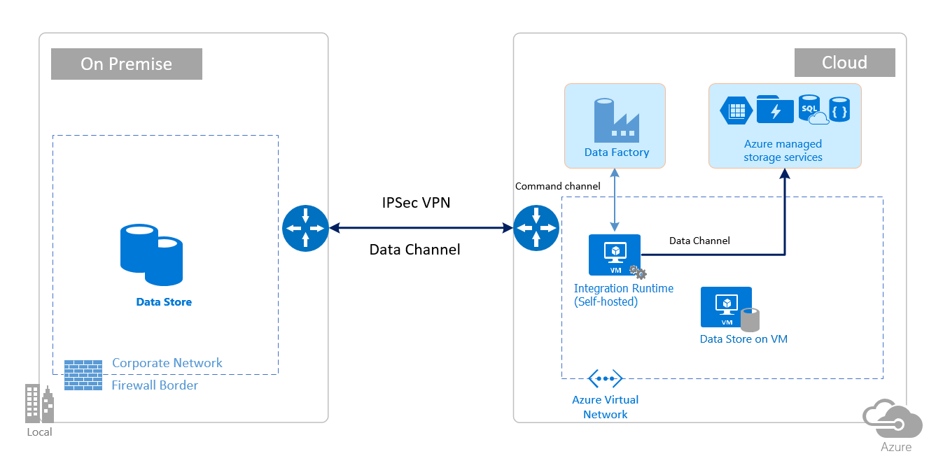
Network Topology (with VPN)

Slide 39
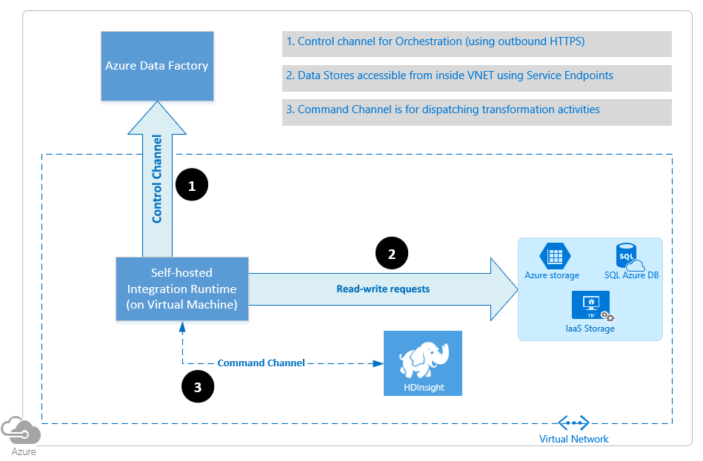
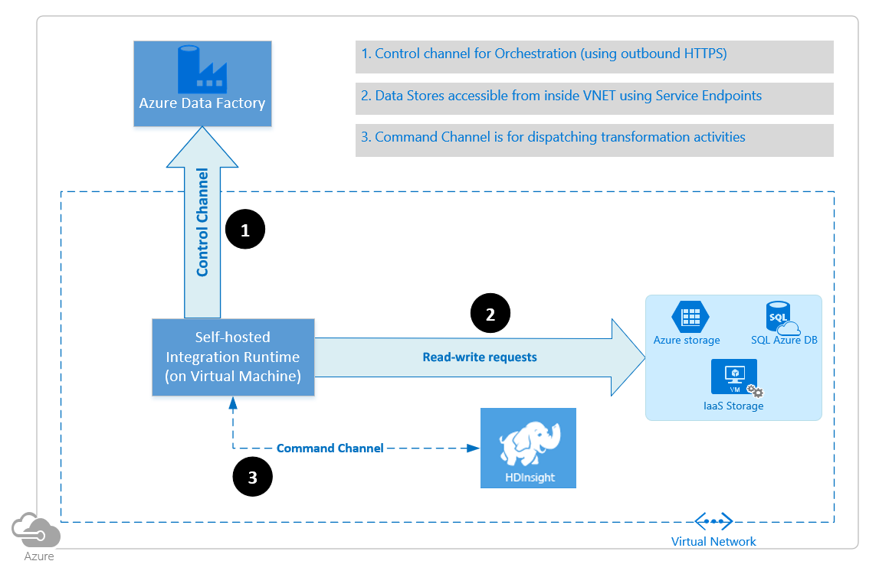

VNet

Slide 40
ADF Certifications
HIPAA/HITECH
ISO/IEC 27001
ISO/IEC 27018
CSA STAR

Slide 41
Customer Insights
SSIS is a traditional ETL tool that comes bundled with SQL Server on premises
Has been around for more than 10 years
Some customers have started to lift & shift their ETL workloads to the cloud to reduce their on-prem infra, but found managing Infrastructure as a Service (IaaS)/VMs challenging

Slide 42
Customer Insights
SSIS is a traditional ETL tool that comes bundled with SQL Server on premises
Has been around for more than 10 years
Some customers have started to lift & shift their ETL workloads to the cloud to reduce their on-prem infra, but found managing Infrastructure as a Service (IaaS)/VMs challenging
Azure Data Factory (ADF) is a modern ELT tool that moves/copies data and dispatches transformations for Big Data Analytics in the cloud
Some gaps in ELT workflows can be filled w/ code-free authoring of transformations/built-in tasks from SSIS
Some customers have started to combine ADF with SSIS on IaaS/VMs, but found managing IaaS/VMs challenging

Slide 43
Customer Insights
SSIS is a traditional ETL tool that comes bundled with SQL Server on premises
Has been around for more than 10 years
Some customers have started to lift & shift their ETL workloads to the cloud to reduce their on-prem infra, but found managing Infrastructure as a Service (IaaS)/VMs challenging
Azure Data Factory (ADF) is a modern ELT tool that moves/copies data and dispatches transformations for Big Data Analytics in the cloud
Some gaps in ELT workflows can be filled w/ code-free authoring of transformations/built-in tasks from SSIS
Some customers have started to combine ADF with SSIS on IaaS/VMs, but found managing IaaS/VMs challenging
Evolution of a cloud-first product: SSIS on premises -> IaaS -> PaaS
The stage is set for SSIS PaaS…

Slide 44


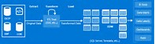
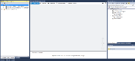
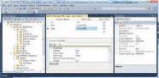
Microsoft ETL/ELT Services in Azure
Introducing Azure-SSIS IR: Managed cluster of Azure VMs (nodes) dedicated to run your SSIS packages and no other activities
You can scale it up/out by specifying the node size /number of nodes in the cluster
You can bring your own Azure SQL Database (DB)/Managed Instance (MI) server to host the catalog of SSIS projects/packages (SSISDB) that will be attached to it
You can join it to a Virtual Network (VNet) that is connected to your on-prem network to enable on-prem data access
Once provisioned, you can enter your Azure SQL DB/MI server endpoint on SSDT/SSMS to deploy SSIS projects/packages and configure/execute them just like using SSIS on premises
ISVs
ML
HDI
Provision
SSIS PaaS w/ ADF compute resource
Cloud
ADF (PROVISIONING)
On-Premises
Design/Deploy
Execute/Manage
SSDT
SSMS
Design/Deploy
SSIS Server
Execute/Manage
Notes:
SSIS PaaS requires VNet to enable on-prem data access for now, but we may also reuse ADF Data Management Gateway (DMG) to do the same in the near future.

Slide 45
Microsoft ETL/ELT Services in Azure
Customer cohorts for Phase 1:
"SQL Migrators"
These are SSIS customers who want to retire their on-prem SQL Servers and migrate all apps + data (“complete/full lift & shift”) into Azure SQL MI – For them, SSISDB can be hosted by Azure SQL MI inside VNet
"ETL Cost Cutters“
These are SSIS customers who want to lower their operational costs and gain High Availability (HA)/scalability for just their ETL workloads w/o managing their own infra (“partial lift & shift") – For them, SSISDB can be hosted by Azure SQL DB in the public network
ISVs
ML
HDI
Provision
SSIS PaaS w/ ADF compute resource
Cloud
ADF (PROVISIONING)
On-Premises
Design/Deploy
Execute/Manage
SSDT
SSMS
Design/Deploy
SSIS Server
Execute/Manage
Notes:
"SQL Migrators": They want Azure SQL MI inside their VNet to maintain network isolation. To support them, we need to have both SSISDB hosted by Azure SQL MI and Azure-SSIS IR inside the same VNet.
"ETL Cost Cutters": They don't necessarily want to migrate their SQL Servers to the cloud, in fact some of their sensitive data must stay on premises. Unlike cohort 1), they don't have strict VNet requirements and accept creating a new VNet to enable on-prem data access. Some of them have just cloud<->cloud ETL scenarios that don't require VNet at all. To support them, we can have SSISDB hosted by Azure SQL DB in the public network and Azure-SSIS IR optionally inside their VNet.

Slide 46
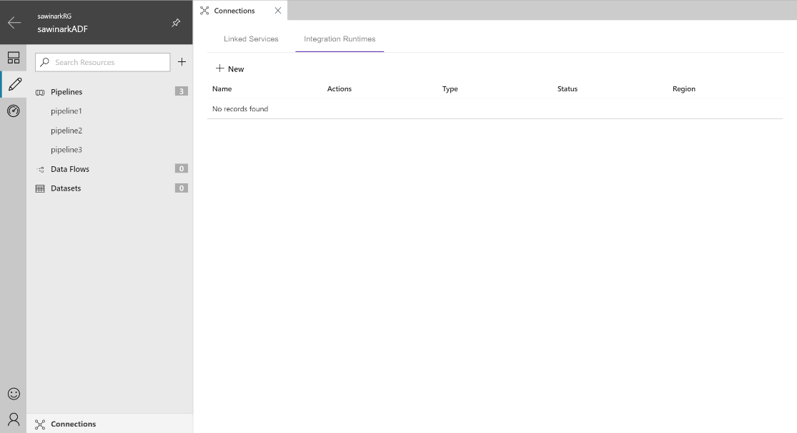
Provision SSIS IR in ADF
Click on “Connections” and
”Integration Runtimes”

Slide 47
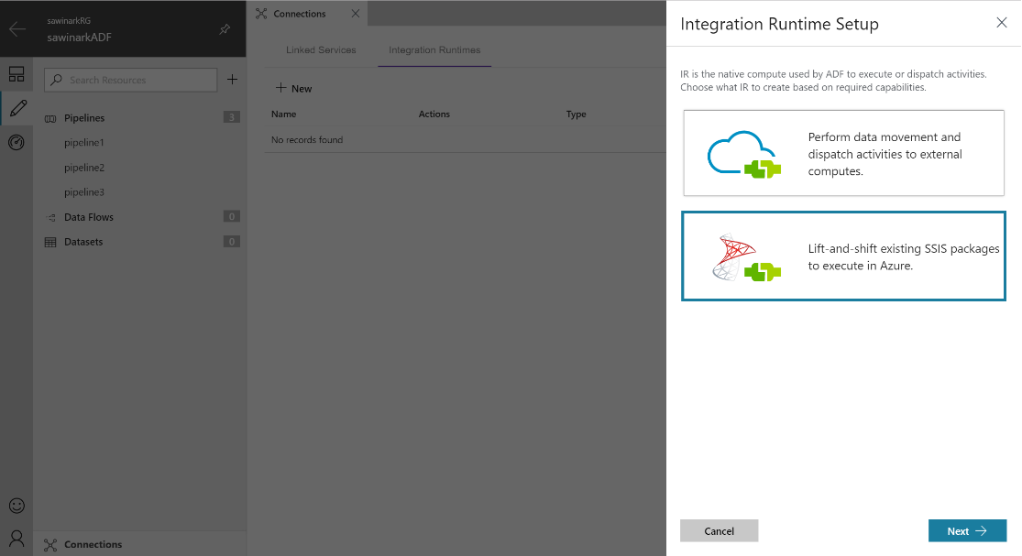
Provision SSIS IR in ADF
Click on “+ New” and
”Lift-and-Shift…”

Slide 48

Provision SSIS IR in ADF

Slide 49

Provision SSIS IR in ADF

Slide 50

Provision SSIS IR in ADF
Once your Azure-SSIS IR is started, you can deploy SSIS packages to execute on it and you can stop it as you see fit

Slide 51
Provisioning via PSH
##### SSIS in ADFv2 specifications (please refer to SSIS in ADFv2 Public Preview documentation for field descriptions) #####
# If your inputs contain PSH special characters, e.g. "$", please precede it with the escape character "`" like "`$".
# ADFv2 info
$SubscriptionName = "[your Azure subscription name]"
$ResourceGroupName = "[your Azure resource group name]"
$DataFactoryName = "[your ADFv2 name]"
$DataFactoryLocation = "EastUS" # In Public Preview, only EastUS|EastUS2 are supported for now
# Azure-SSIS Integration Runtime info - This is ADFv2 compute resource for running SSIS packages
$AzureSSISName = "[your Azure-SSIS Integration Runtime name]"
$AzureSSISDescription = "This is my Azure-SSIS Integration Runtime"
$AzureSSISLocation = "EastUS" # In Public Preview, only EastUS|NorthEurope are supported for now
$AzureSSISNodeSize = "Standard_A4_v2" # In Public Preview, only Standard_A4_v2|Standard_A8_v2|Standard_D1_v2|Standard_D2_v2|Standard_D3_v2|Standard_D4_v2 are supported for now
$AzureSSISNodeNumber = 2 # In Public Preview, only 1-10 nodes are supported for now
$AzureSSISMaxParallelExecutionsPerNode = 2 # In Public Preview, only 1-8 parallel executions per node are supported for now
$VnetId = "[your VNet resource ID or leave it empty]" # OPTIONAL: In Public Preview, only Classic VNet is supported for now
$SubnetName = "[your subnet name or leave it empty]" # OPTIONAL: In Public Preview, only Classic VNet is supported for now
# SSISDB info
$SSISDBServerEndpoint = "[your Azure SQL Database server name.database.windows.net or your Azure SQL Managed Instance server endpoint]"
$SSISDBServerAdminUserName = "[your server admin username]"
$SSISDBServerAdminPassword = "[your server admin password]"
$SSISDBPricingTier = "[your Azure SQL Database pricing tier, e.g. S3, or leave it empty for Azure SQL Managed Instance]" # Not applicable for Azure SQL Managed Instance
##### End of SSIS in ADFv2 specifications #####

Slide 52
Deployment Methods
SSIS PaaS supports the project deployment model used in SSIS 2012/later versions
Projects built in the legacy package deployment model used in SSIS 2008/earlier versions can be converted into this model via SSDT/SSMS using Integration Services Project Conversion Wizard
Packages built in SSIS 2008/earlier versions can be upgraded to the latest version supported by SSIS PaaS via SSDT/SSMS using SSIS Package Upgrade Wizard
In this model, the whole project needs to be deployed after any package changes – An incremental package deployment feature will be provided in the near future
Projects containing environment references/run-time parameters can be saved into project deployment files (.ispac extension)
Projects are deployed into SSISDB hosted by Azure SQL DB/MI server, packages are run by creating/starting jobs via SSISDB sprocs that will be executed on Azure-SSIS IR, and execution logs are written back into SSISDB
Notes:
SSIS PaaS always supports the latest SSIS version, so new features will be frequently released cloud-first to SSIS PaaS and then backported to on-prem box products later.

Slide 53
Deployment Methods
SSIS projects can be deployed via SSDT/SSMS using Integration Services Deployment Wizard
SSIS projects can be deployed via Command Line Interface (CLI)
Run isdeploymentwizard.exe from the command prompt (TBD)
SSIS projects can be deployed via custom code/PSH using SSIS Managed Object Model (MOM) .NET SDK/API
Microsoft.SqlServer.Management.IntegrationServices.dll is installed in .NET Global Assembly Cache (GAC) with SQL Server/SSMS installation
SSIS projects can be deployed via T-SQL scripts executing SSISDB sprocs
Execute SSISDB sproc [catalog].[deploy_project]
Notes:
Running isdeploymentwizard.exe from the command prompt might only be needed for automatic deployments from batch files.

Slide 54


Deployment via SSMS
on premises
On SSMS, you can connect to SSIS PaaS using its connection info and SQL/AAD authentication credentials

Slide 55

Deployment via SSMS
on premises
On “Connection Properties” tab, enter “SSISDB” as the target database to connect

Slide 56

Deployment via SSMS
in Azure
Once connected, you can deploy projects/packages to SSIS PaaS from your local file system/SSIS on premises
on premises

Slide 57

Deployment via SSMS
On Integration Services Deployment Wizard, enter SSIS PaaS connection info and SQL authentication credentials
Notes:
SSIS PaaS connection info and SQL authentication credentials need to be entered again, since Integration Services Deployment Wizard is a separate executable from SSMS.

Slide 58

Execution via SSMS
in Azure
Once deployed, you can configure packages for execution on SSIS PaaS
on premises

Slide 59

Execution via SSMS
You can set package run-time parameters/environment references

Slide 60

Execution via SSMS
in Azure
Once configured, you can execute packages on SSIS PaaS
on premises

Slide 61

Execution via SSMS
You can select some packages to execute on SSIS PaaS

Slide 62

Monitoring via SSMS
in Azure
You can see reports of all package executions on SSIS PaaS
on premises

Slide 63


Monitoring via SSMS
in Azure
You can see package execution error messages
on premises

Slide 64

Scheduling via On-Prem SQL Server Agent
in Azure
on premises
You can schedule T-SQL jobs to execute packages on SSIS PaaS via on-prem SQL Server Agent

Slide 65


Scheduling via On-Prem SQL Server Agent
T-SQL jobs can execute SSISDB sprocs in Azure SQL DB/MI server that has been added as a linked server to on-prem SQL Server

Slide 66


Execution via ADF
Execute SSIS package from SSISDB hosted in the Cloud and choose environments for parameters
Execute SSIS Package Activity

Slide 67



Scheduling via ADF Wall-Clock Triggers

Slide 68



Monitoring via ADF
SSISDB execution ID from the output of the pipeline activity run can be used to check more comprehensive execution logs and error messages in SSMS

Slide 69

Automatic Data warehouse generating firm cuts development time by a third
Challenge
Most of Concentra customers were challenged by disparate data sources from hybrid and multi-cloud environments. As the customers varied in size, it was difficult to maintain scale without adding infrastructure.
As the firm’s data warehouse practice grew, maintenance of existing data warehouses increasingly required process updates to accommodate changes to data feeds, especially those of healthcare and government customers.
Solution
Build Software-as-a-service on Azure to automate data-driven workflows with SQL Server Integration Services in Azure Data Factory, creating an easy-to-use, cloud-based version of their data warehouse generator.
Customers can redeploy their existing SSIS packages from on premises environments to Azure with minimal modification in managed SSIS environment in Azure Data Factory.
Time to production – 3 weeks
100 GB data moved weekly
Saved 3 months of development effort by moving to cloud
Notes:
Lift SSIS to Azure with Azure Data Factory

Slide 70


Adobe uses global cloud to create, deliver, and manage better digital experiences
Challenge
Developers building out the next generation of consumer experiences need a semantic platform with curated data, APIs and machine learning services on top, designed explicitly for that purpose.
Bringing massive volume of behavioral and experience data across on-premises, cloud and SaaS applications that needs to be ingested at scale, prepared and transformed into experience data models.
Solution
With Azure Data Factory, Adobe can connect to hybrid data sources and ingest data at scale into the lake powering the Adobe cloud platform.
Data may consist of CRM data, e-commerce transactions, offline transactions, loyalty program data, behavioral data from mobile, web or emails, and social interaction data.
2M activity runs per month
10 TB data moved per month
Time to production – 6 months
Expedited go to market by 6 months
Pulling data from Salesforce, Dynamics, AWS S3, MySQL and FileShare

Slide 71



Online retailer uses cloud database to deliver world-class shopping experiences
Challenge
With increasing amount of customer data in various forms and shapes and telemetry from disparate data sources, it was difficult to integrate the data, manage infrastructure and scale with customer needs.
As the data grew more sophisticated, building intelligent recommendations and monitoring and debugging transformations on big data compute was complex and time consuming.
Solution
With Azure Data Factory, ASOS can easily ingest data from disparate sources in a serverless manner and is now able to debug, monitor and manage the solutions from a single pane of glass. ASOS easily integrated custom code to drive intelligent recommendation within the data factory pipeline.
The online recommendations service is able to elastically scale throughput and maintain high availability to handle peak holiday shopping seasons.
12K activity runs per week
Time to production – 3 months
Product recommendations and instant order updates for 15.4 million customers
167 million ASOS customer requests in 24 hours , handling 3,500 requests, 33 orders a second, average response time of 48 milliseconds

Slide 72


Consumer goods firm empowers employees to work smarter using big data
Challenge
Data. To make good decisions, salespeople, marketers, product developers, and executives all need data to understand what’s going on with the business and the team realized that to gain those kinds of crystal-ball insights, RB needed more than just internal operational data, they needed third-party data.
Need to do a better job of helping employees make sense of proliferating data.
Solution
Use Microsoft Azure to build a modern data warehouse solution to replace AWS data warehouse and Hadoop components and save money in the process.
Bring together a variety of data from different sources using Azure Data Factory in Azure HDInsight and Azure SQL Data Warehouse and make it easily accessible in one view across the organization.
7.1 TB data moved weekly
4.7K activity runs per week
Time to production – 2.5 months

Slide 73


Improved Health Outcomes by integrating healthcare data
Challenge
Integration of Healthcare data from multiple hospitals and heterogenous sources
Transformation and orchestration of dataflow at scale
Increasing costs of scaling on-premise data pipelines
Solution
Built end-to-end data integration with Azure Data Factory, leveraging big data and compute offerings in Azure
Enabled data ingestion from hybrid sources of data
Orchestrated complex data workflows at scale
Notes:
Why: Modern Data Warehouse for healthcare analytics. Ingesting data from various hospital chains into Azure,
transforming the data in ADL and then loading SQL DW for powering various analytics
How: Their end-to-end scenario involves using the Lookup Activity and Web Activity to recreate the source
schema from On-prem SQL on the final destination in Azure SQL. They then use the ForEach activity to copy in a
loop to ADLS (where they do transformations with USQL) and do the final copy to Azure SQL.
“We are in the journey of modernizing our enterprise data warehouse into Azure and Data Factory has helped us expedite the process by offering a comprehensive end to end data integration platform enabling us to ingest data from hybrid sources and orchestrate complex workflows at scale leveraging big data and compute offerings in Azure.

Slide 74


Industrial automation firm cuts up to 90 percent of costs
Challenge
Manage data in excess of the existing data warehouse and systems capacity
Integrate data on-premises with cloud and batch processing with live streaming
Monitor a complex supply chain – undersea wells, refining facilities, gas stations
Solution
Integrated complex data systems with Azure Data Factory
Composed, orchestrated, and managed highly available data pipelines
Reduced up to 90 percent of costs
Notes:
Industrial automation firm cuts costs up to 90 percent with Big Data solutions
Challenge
The need to manage increasing amount of data that outgrew the capacity of our internal data warehouse required integration with the company’s existing systems, as well as integrating on-premises with cloud, and batch processing with live streaming.
Monitor a complex supply chain that encompasses undersea wells, remote refining facilities, and neighborhood gas stations
Solution
Rockwell Automation uses Azure Data Factory and other Azure technologies to solve the challenge of integrating complex data systems.
ADF enabled us to compose, orchestrate, and manage highly available and reliable data pipelines, which consist of sets of data and the services orchestrated to process them.

Slide 75



Actuarial firm unlocks the potential of human capital to drive business
Challenge
Increasing complexity of insurance products and regulations
Diversion from firm’s core purpose
Rise in on-premises hardware investments to handle high-performance grid computing
Solution
Built software-as-a-service on Azure to address modeling and reporting of large, compute-intensive workloads and used Azure Data Factory to automate extract, transform, and load (ETL) processes
Gained real-time insight into financial data
Notes:
Unlock the potential of human capital to drive business, not simply manage it
Challenge
Increasing complexity of insurance products and regulations diverted actuaries from their core purpose, which is to provide insights that help insurers and other organizations minimize risk and make better business decisions.
As the analytics grew more sophisticated, the high-performance grid computing that was required to produce the scenarios demanded increasingly large investments in on-premises hardware.
Solution
Build Software-as-a-service on Azure to address modeling and reporting of large, compute-intensive workloads and use Azure Data Factory to automate extract, transform, and load (ETL) processes and gain real-time insight into their financial data.

